Slide 1
Statistical Tools and Concepts for Molecular Biologists
Session 6: Introduction to Statistical Models

Slide 2
Selection and implementation of statistical models (Sessions 6-7)
Parametric vs non-parametric tests
t-tests
ANOVA
Linear regression
Correlation
Calculation of R²

Slide 3
What is a statistical model?
A model is a simplified description of a mechanism (e.g. mouse model of autism, organoid model of liver development).
A statistical model is a mathematical representation of your observed data that attempts to describe the population you are sampling in order to:
Provide a framework of assumptions about populations
Make comparisons between groups
Predict future outcomes
Different statistical tests use different statistical models in order to calculate the probability (e.g. p-values) that a given hypothesis is true or not true
Notes:
https://www.youtube.com/watch?v=KOBaNFEyrLA

Slide 4
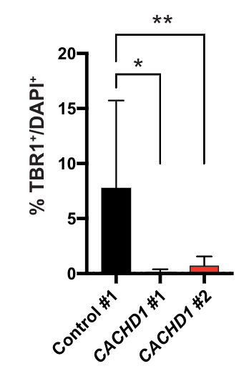
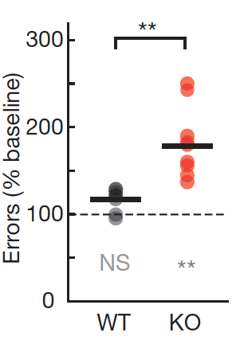
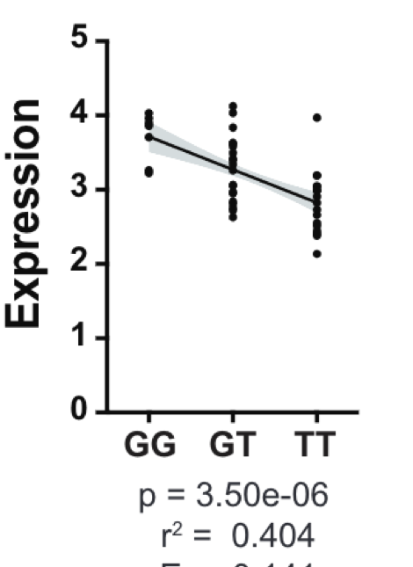
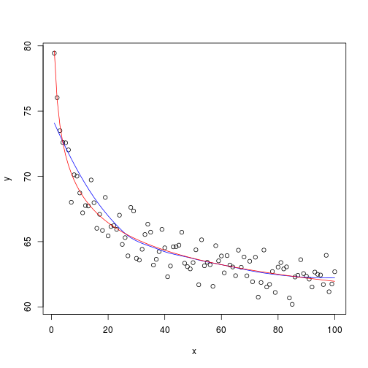
Examples of statistical models
Linear regression
Non-Linear regression
Mean
Median

Slide 5
What are the major types of statistical models?
Parametric models make assumptions about a population’s parameters:
Normality—Data in each group is normally distributed
Independence—Data in each group is randomly and independently sampled
Homoscedasticity—Data in each group has roughly the same variance or spread
Advantages include more power (ability to detect a true difference), lower chance of Type II errors (false negative), and in general easier to compute.
Non-parametric models make no assumptions about population and are used when:
You don’t know the distribution or don’t want to make assumptions
Data is ranked ordinal (e.g. low, medium, high)
One or more groups fail to meet the criteria for parametric models
Also common for experiments with small sample sizes

Slide 6
Parametric vs Non-parametric tests
Parametric | Non-parametric
Unpaired t-tests | Mann-Whitney test
Paired Samples t-tests | Wilcoxon Signed Rank test
One-Way ANOVA | Kruskal Wallis test
One-Way Repeated Measures ANOVA | Friedman’s ANOVA
Pearson’s R | Spearman’s R
USE PARAMETRIC MODELS/TESTS WHEN YOU CAN
Notes:
Most if not all parametric tests have a non-parametric equivalent

Slide 7
One more thing—Degrees of Freedom
The degrees of freedom (df) are the number of independent pieces of information you need to reach a conclusion or calculate a statistic (e.g. mean)
Refers to the maximum number of logically independent values in a sample (e.g. N-1)
Used to calculate standard deviation and perform t-tests
Example #1: Tossing a coin has one of two outcomes—heads or tails. If you toss heads, you also know that you don’t have tails. You only need one piece of information (df = 1).
Example #2: You tell a potential employer you have a graduate degree from a UC school, but they have to guess which one from the 10 options. They need to know which 9 you didn’t attend before they can make the correct guess (df = 9).
Example #3: You calculate a mean of 10 for a n = 3 sample. The first and second values are 8 and 10. The third MUST be 12. Because only two values can vary, df = 2.
Notes:
https://www.youtube.com/watch?v=rATNoxKg1yA

Slide 8
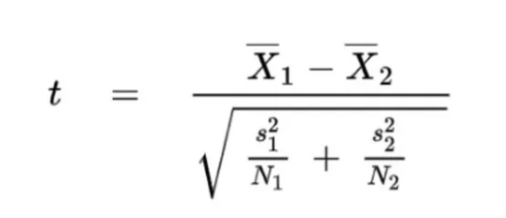
T-tests
A t-test uses characteristics of the means and standard deviations of two groups to test the probability that a null hypothesis is true.
Null hypothesis: the true difference between the two groups is 0
Alternative hypothesis: the true difference between the two groups is not 0
T-tests calculate t-statistic which measures that size of the differences in means for two samples relative to pooled variation. Degrees of freedom are equal to N₁ + N₂ – 2.
The larger the t-stat, the lower the probability that your null hypothesis is correct and the lower the p-value
Notes:
X = mean
S – SE
N = sample size

Slide 9
Types of t-tests
A Student’s t-test is a t-test that assumes that the two groups are (1) normally distributed, (2) independent of each other, and (3) have equal variances
A Welch’s t-test is a t-test that assumes that the two groups are (1) normally distributed, (2) independent of each other, and (3) have unequal variances. Can also be used if samples sizes are unequal.
Note: It is generally recommended to use a Welch’s T-test because it creates a more accurate probability if samples have unequal variances, but is equally accurate to a Student’s t-test when the samples have equal variance

Slide 10
One-tailed vs Two-tailed t-tests
A two-tailed t-test (aka two-sided t-test) determines if there is a difference (in either direction) between two groups
This is the standard approach if you have no reason to believe that one group will be have a larger or smaller mean
Null hypothesis: the true difference between the two groups is 0
Alternative hypothesis: the true difference between the two groups is not 0
A one-tailed t-test determines if there are significant group differences in one direction
This is the approach if you hypothesize one group will be larger/smaller than other
Has more statistical power than two-tailed
Null hypothesis: the true difference between the two groups is 0
Alternative hypothesis: Group A > Group B or Group A < Group B

Slide 11
Unpaired vs paired t-tests
An unpaired t-test assumes the groups and samples are independent of each other
Student’s and Welch’s are unpaired
A paired t-test (or matched t-test) assumes groups or samples may be dependent on each other
Repeated measures experimental designs (i.e. looking at subjects measured at two different time points) are paired because value at time 1 may influence value at time 2
Before and after treatment experimental designs are also paired

Slide 12
ANOVA
ANOVA (or Analysis of Variance) tests are used to analyze the difference in means between more than two groups.
Calculates mean and variance of each dataset that is grouped by independent variable (e.g. CRISPR guide treatment) and compares them to the overall mean of the dependent variable (e.g. organoid size).
Null hypothesis: there are no differences among group means
Alternative hypothesis: at least one group differs significantly from the overall mean of the dependent variable
Assumptions of ANOVA
Observations are independent from one another
The dependent variable is normally distributed
The variance between each group being compared is similar

Slide 13
One-way vs Two-way ANOVA
One-way ANOVA tests the differences in mean for one independent variable between more than two groups.
You should use a one-way ANOVA when you have data about one categorical independent variable (e.g. CRISPR guide treatment) and one quantitative dependent variable (e.g. organoid size)
Two-way ANOVA tests the difference in one dependent quantitative variable (e.g. organoid size) for two independent variables (e.g. CRISPR guide treatment and time)
Three null hypotheses being tested:
There is no difference in group means at any level of the first independent variable
There is no difference in group means at any level of the second independent variable
The effect of one independent variable does not depend on the effect of the other independent variable (there is no interaction between variables)

Slide 14
Post-hoc ANOVA tests
ANOVA determines if one group is different from any other group and if there might be interactions between variables. It does not tell you which group is different.
You can follow up your ANOVA tests with Multiple Comparison tests to determine which group is significantly different.
Dunnett’s method compares means from several experimental groups against a control group mean to see if there is a difference. It generates p-values for each of these comparisons.
Tukey’s method would be used if there was not a control sample or group. It compares all pairs of mean.

